Slide 1
BRITISH AIRWAYS
Task 1: Web Scraping & Data Analysis.
Name : Hafiz Hassan Mustafa.

Slide 2
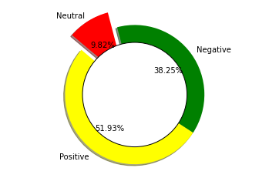
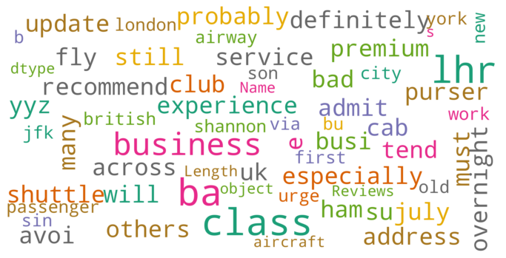
Customer Reviews
Positive 1792
Negative 1320
Neutral 339
Word Analysis:

